Slide 1

MMR Vaccination Trends
Melissa Lowe
Fukhrudin Maalim
Rylee Nelson
Terra Vaughn
“I am not throwing away my shot!”
-L. Miranda, Hamiltion: An American Musical
Image Source: Google Images
Notes:
Name of project
Team members

Slide 2

Our Thought Process
Too soon?
COVID
Vaccine
How about school vaccination rates?
Likely no data yet
Anti-Vaxxers
2 of us have little ones at home
We were all little once
Can we find
data?
Yes! Let’s do it!
https://www.kaggle.com/jessemostipak/measles-immunization-rates-in-us-schools
Notes:
Describe the questions you and your group found interesting, and what motivated you to answer them -
This year of COVID has us all thinking about vaccinations, and we began thinking about vaccination trends in general in pop culture today. We tracked into the anti-vax movement and all of the misinformation around the COVID Vaccine and began wondering how immunization rates varied over time. When we searched for this data, we found MMR Vaccination rates data and decided to analyze along the lines of different school types rather than over time based on the data set.

Slide 3
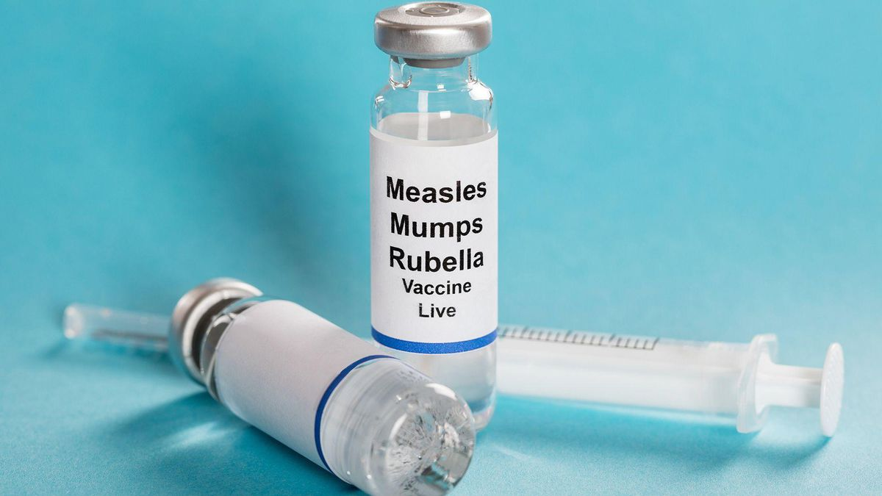
Hypothesis:
Null Hypothesis:
MMR immunization rates should vary based on school type (public, private, kindergarten, other).
There is no difference among MMR immunization rates of different school types (public, private, kindergarten, other).
Image Source: Google Images
Notes:
Rylee
Some states have religious and personal belief exemptions. Some private schools are religious, so those schools may have lower immunization rates. Public schools have an extremely rigorous immunization requirements, so they should have higher immunization rates. Other school types don’t have as strict of policies regarding immunization requirements, so their rates should be lower.

Slide 4
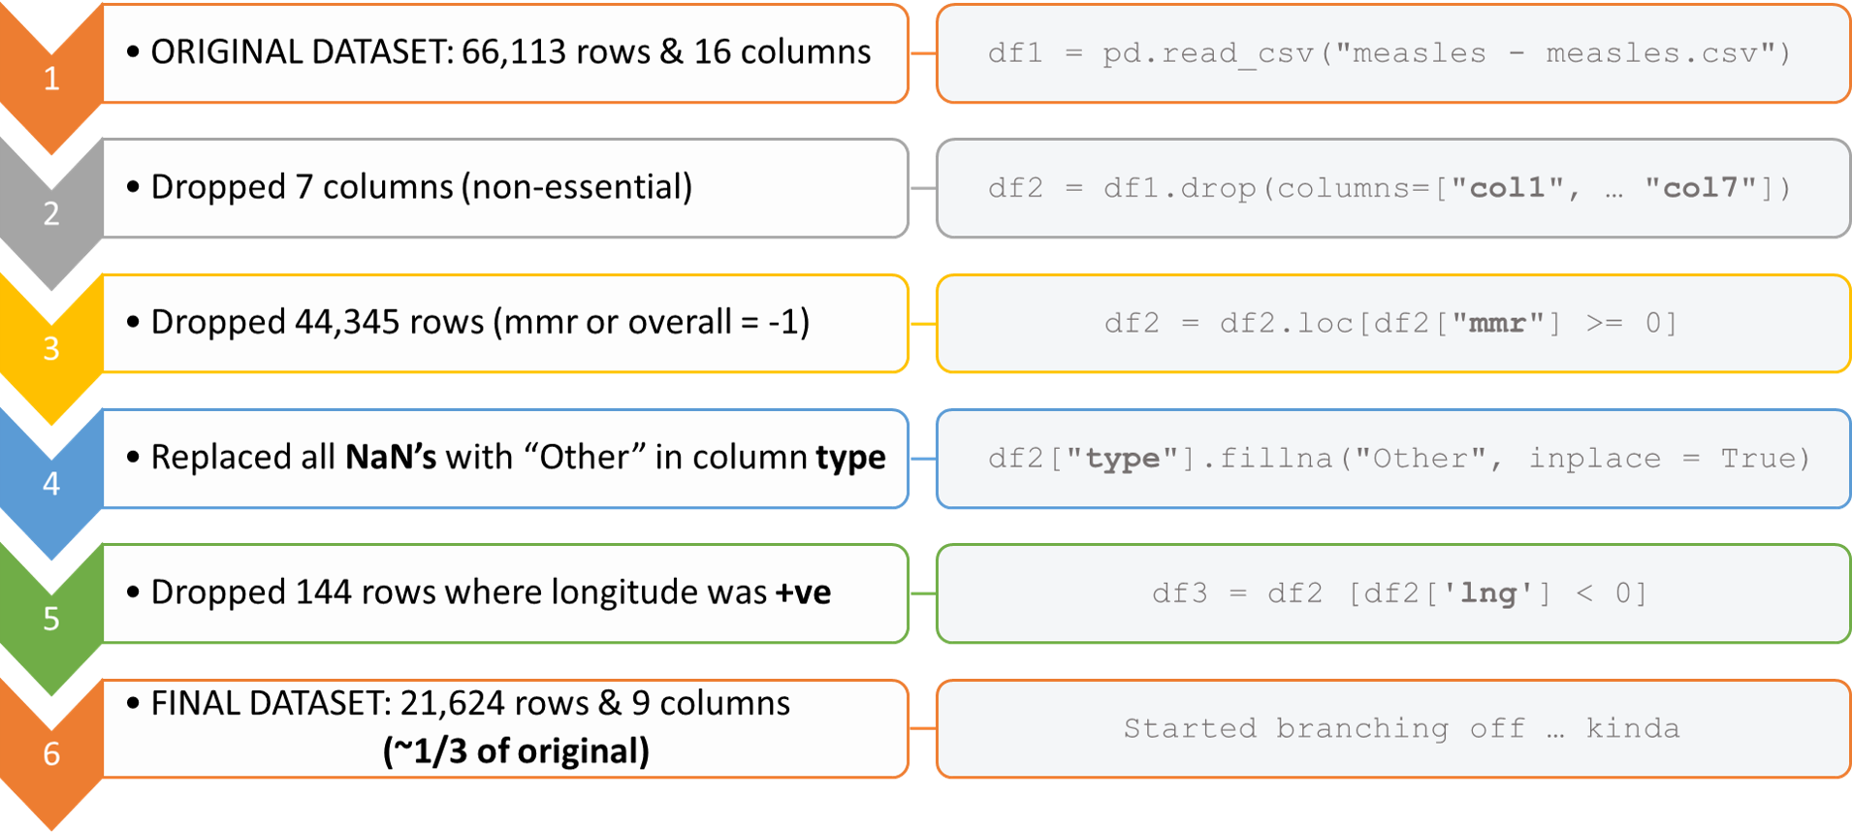
Cleaning the Data
Notes:
FKM: Cleanup Data
Discuss insights you had while exploring the data that you didn't anticipate: We had russian data (bad longitude values).
Problems? - Maybe move to earlier slides; troubleshoot on Monday
States which had clean data didn’t have consistent school type reporting so we couldn’t compare all states with the same manner, but not each state is represented in an equal way.
We couldn’t use the -1 values for MMR rate of immunization because we couldn’t find out what that specific value meant for the data.
Discussion:
Melissa comes in at the end of this slide to do this: Present and discuss interesting figures developed during exploration, ideally with the help of Jupyter Notebook (different bar charts, boxplot)
Flagging states with school types, bar charts first, boxplot next, then stats.
Rylee: Explains hypothesis tests. Talk about removing outliers difficulties.

Slide 5
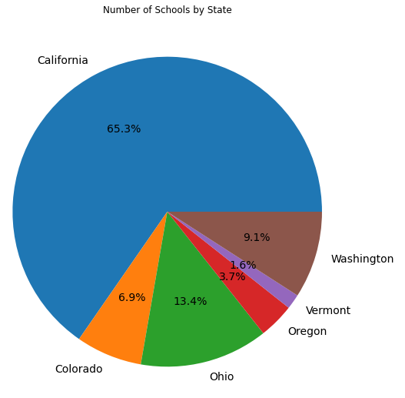
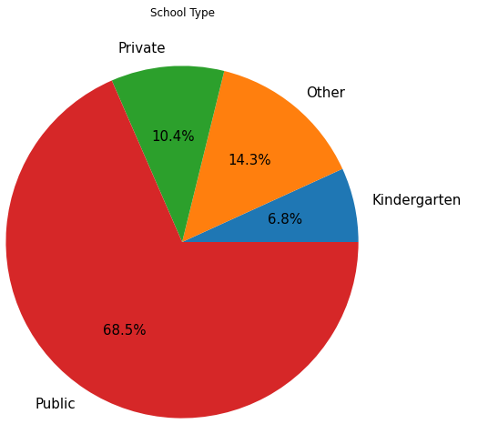
MMR Vaccination Overview by State and by School Type
GITHUB
Notes:
Data was provided by the state health departments
Original data: 16,000 schools in 8 states
Remaining data: National Center for Education Statistics’ school directories and the states’ school directory
Vaccination rate differences between different school types (public, private, etc.) and differences between states.

Slide 6
Data Summary and Conclusions
T-test pairs | With Outliers p-value | Without Outliers p-value
Public and Kindergarten | 4.4358036238342905e-13 | 9.22064324541552e-24
Public and Private | 6.555688834799406e-51 | 6.022047238728933e-134
Public and Other | 6.735876076356765e-130 | 4.78528524653695e-270
Kindergarten and Private | 0.0002379061203745497 | 0.2288244860245795
Kindergarten and Other | 8.414602855892066e-26 | 3.0779097249208934e-40
Private and Other | 4.526050894470002e-16 | 4.968781246618259e-76
ANOVA with 3 School Types
Excluding Public | 5.531556747561414e-29 | 8.556376134536471e-78
Excluding Private | 3.244387849026671e-228 | 0.0
Excluding Kindergarten | 1.6646963060659216e-253 | 0.0
Excluding Other | 2.5125465603433475e-76 | 2.9975591002774383e-240
Initial ANOVA Testing Results (all 4 types)
With Outliers:
p=1.53 e-248
Without Outliers:
p=0.0
What would we do if we had more time?
Notes:
Discuss any additional questions that came up, but which you didn't have time to answer: What would you research next, if you had two more weeks?
We wanted to know how the immunization rates differed by state and by time. We thought that different states having different requirements for vaccination exemption would allow for varied rates. Also, we wanted to know if immunization rates across school types were dropping; we thought this may be the case because of the growing coverage in recent news.
Open-floor Q&A with the audience.
Describe the data exploration and cleanup process (accompanied by your Jupyter Notebook)
Link in the powerpoint to github maybe? Maybe not a live jupyter notebook and just snapshots of our graphs and code?

Slide 7
Thank you!
Any questions?

